Slide 1
BigQuery

Slide 2
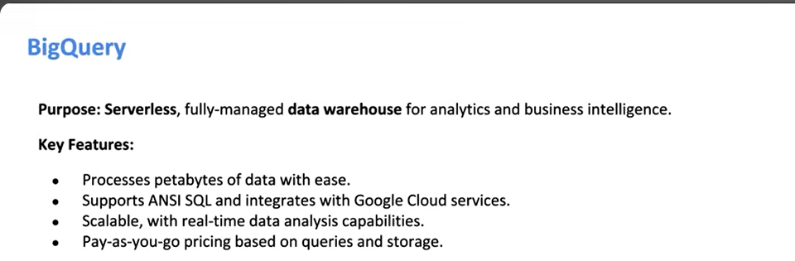

Slide 3

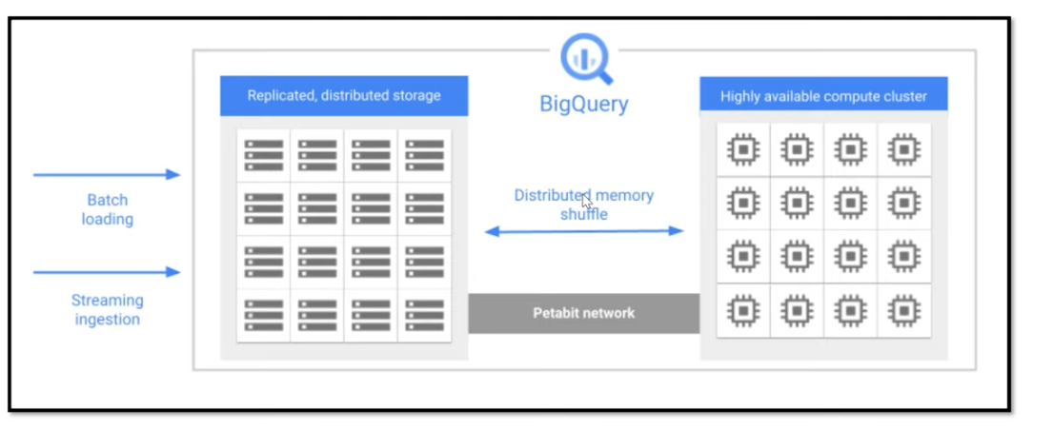

Slide 4

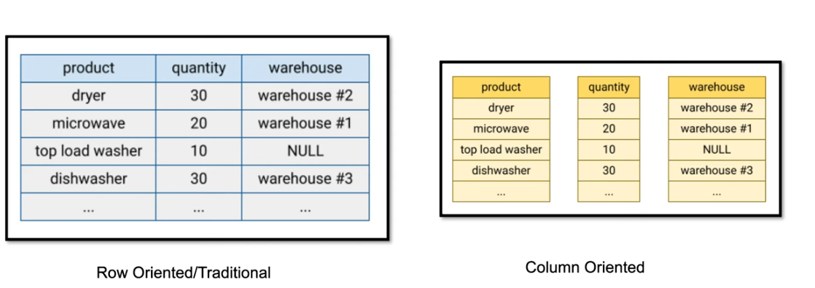

Slide 5
Data Cleansing
Data cleansing or data cleaning is the process of identifying and correcting corrupt, inaccurate, or irrelevant records from a dataset, table, or database.
It involves detecting incomplete, incorrect, or inaccurate parts of the data and then replacing, modifying, or deleting the affected data.
When combining multiple data sources, there are many opportunities for data to be duplicated or mislabeled.
If data is incorrect, outcomes and algorithms are unreliable, even though they may look correct.

Slide 6
Remove duplicate or irrelevant observations
Fix Schema Level issues
Filter unwanted outliers
Handling missing data
Data aggregation
Data Scrubbing
Data Transformations
Data Validation for Data Quality

Slide 7
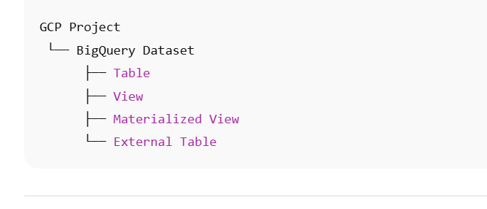
BigQuery dataset
A BigQuery dataset is a logical container inside a GCP project that holds:
Tables
Views
Materialized views
External tables
It also defines where the data lives (region) and who can access it (permissions).

Slide 8
Why datasets matter in BigQuery
A dataset controls:
1️⃣ Location
US
EU
asia-south1, etc.
⚠️ Tables cannot join across different locations.
2️⃣ Access control (IAM)
You assign permissions at dataset level:
bigquery.dataViewer – read only
bigquery.dataEditor – read/write
bigquery.dataOwner – full control
3️⃣ Organization
Instead of dumping everything together:
raw_data
staging
analytics
reporting
This is best practice in real projects.

Slide 9
Types of BigQuery datasets
1. Standard (native) dataset
Data is stored inside BigQuery
Fastest performance
Best for analytics & dashboards
CREATE TABLE sales.orders (
order_id INT64,
amount FLOAT64
);
2. External dataset
Data lives outside BigQuery
BigQuery only queries it
Supported sources:
Cloud Storage (CSV, JSON, Parquet, Avro)
Cloud Spanner
Bigtable
Cloud SQL (via federation)
✔ No data duplication ❌ Slower + query costs on source

Slide 10
Dataset pricing basics
Creating a dataset:
✅ Free
Costs depend on:
Storage (for native tables)
Query processing (data scanned)
External source reads (if external dataset)

Slide 11
Dataset lifecycle (typical data engineering flow)
raw_dataset – ingested data
clean_dataset – cleaned/validated
curated_dataset – business-ready
reporting_dataset – BI views

Slide 12
Common BigQuery dataset commands
Create dataset
CREATE SCHEMA my_project.sales_data
OPTIONS (
location = "asia-south1"
);
List datasets
SELECT schema_name
FROM my_project.INFORMATION_SCHEMA.SCHEMATA;
Delete dataset
DROP SCHEMA my_project.sales_data CASCADE;

Slide 13
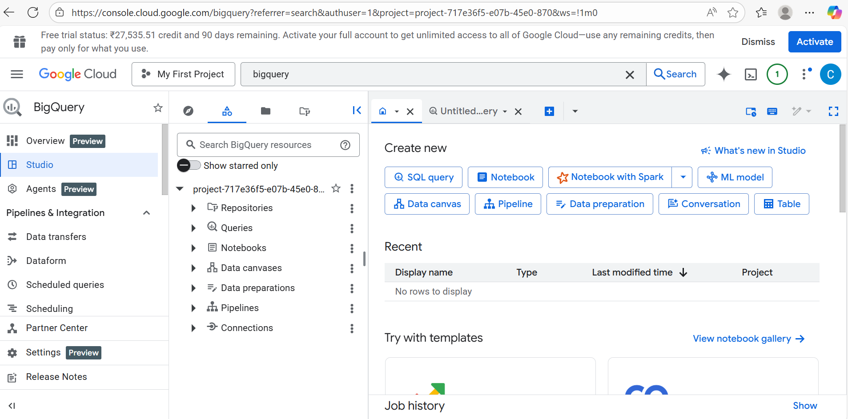

Slide 14
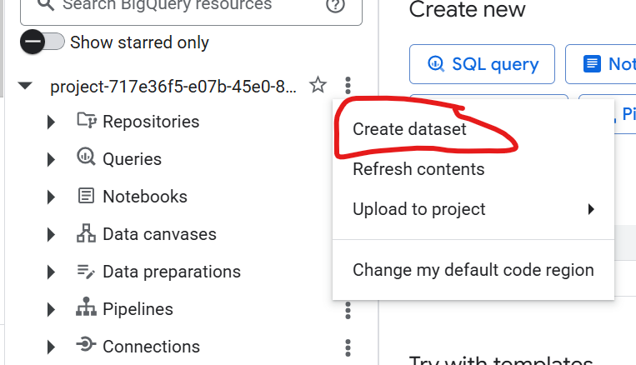

Slide 15
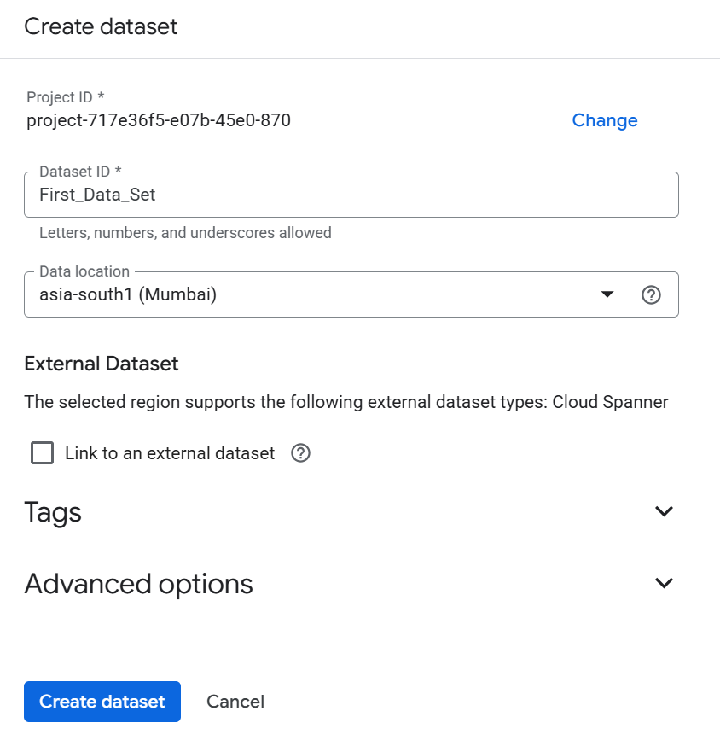

Slide 16
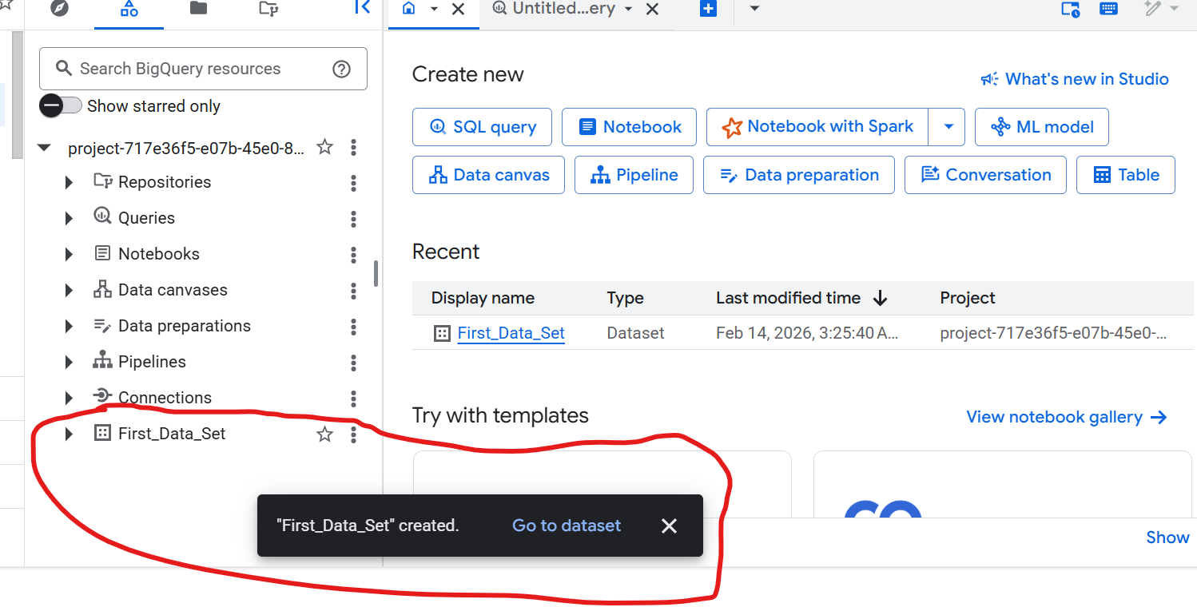

Slide 17
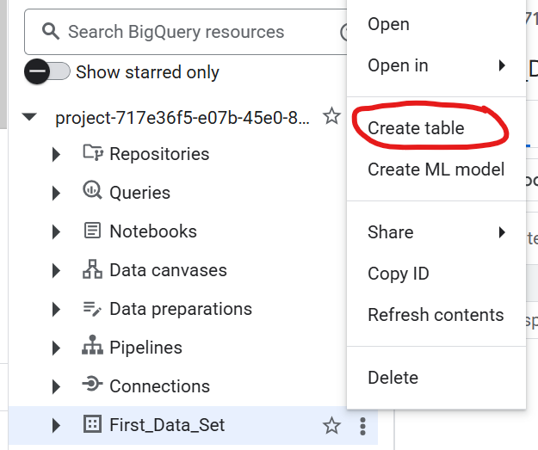
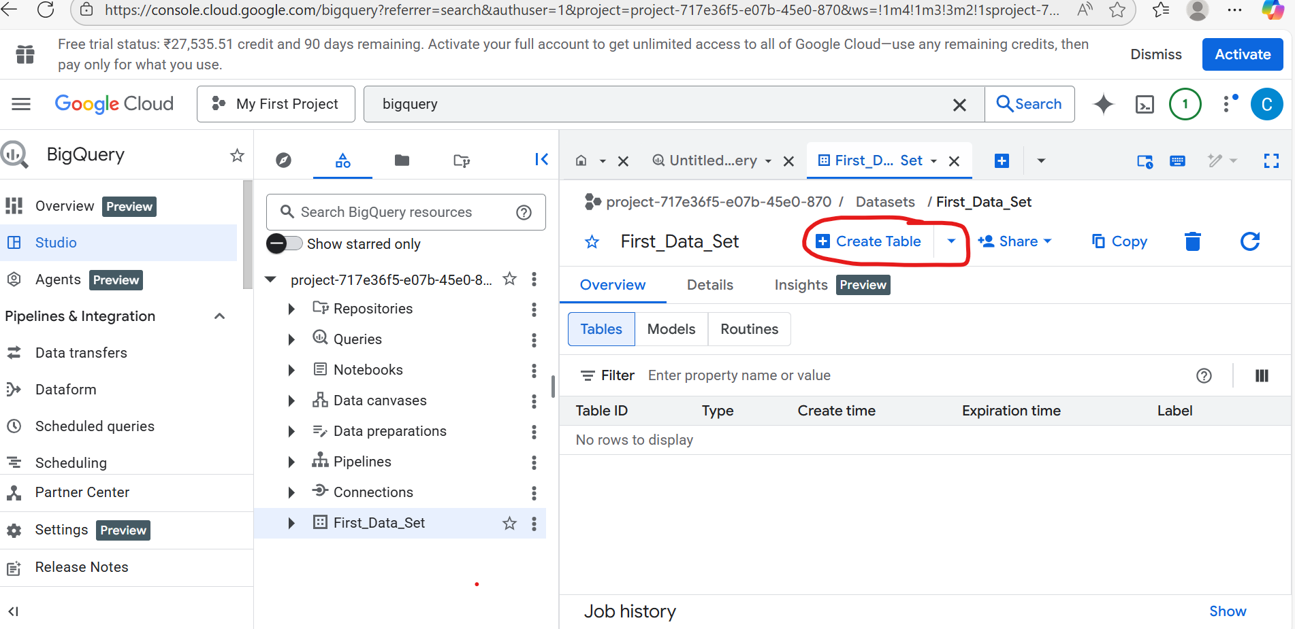
Click on Go to dataset- Create table

Slide 18
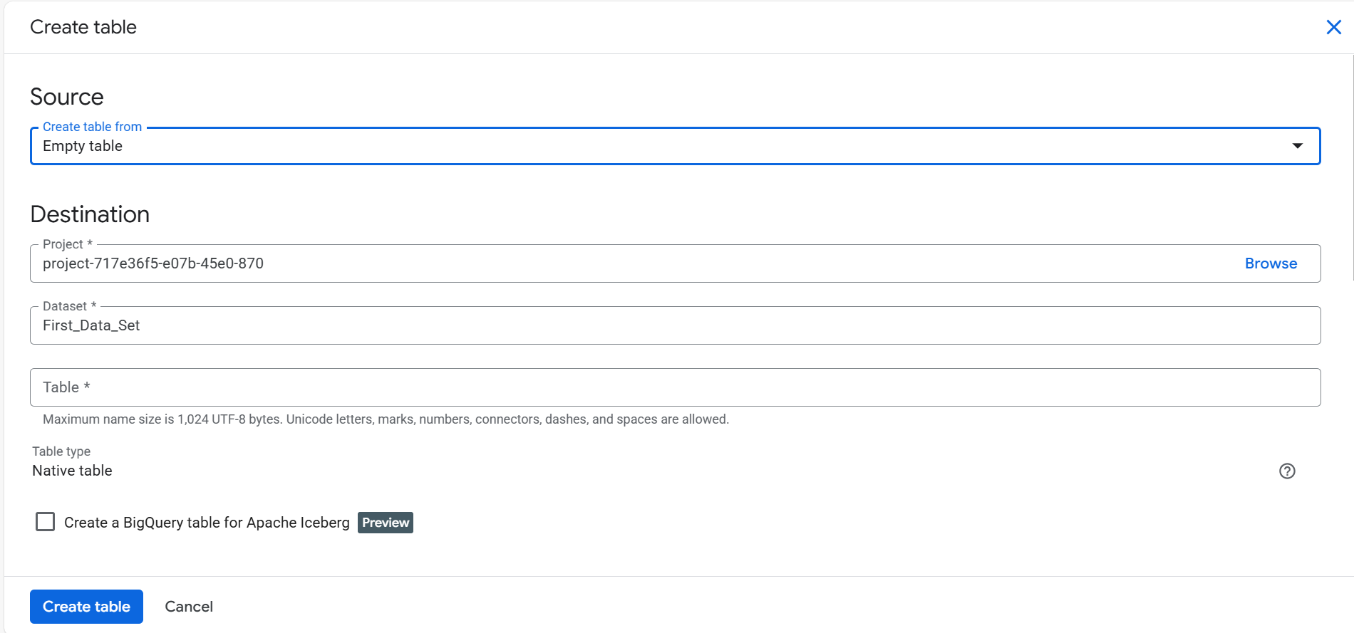

Slide 19
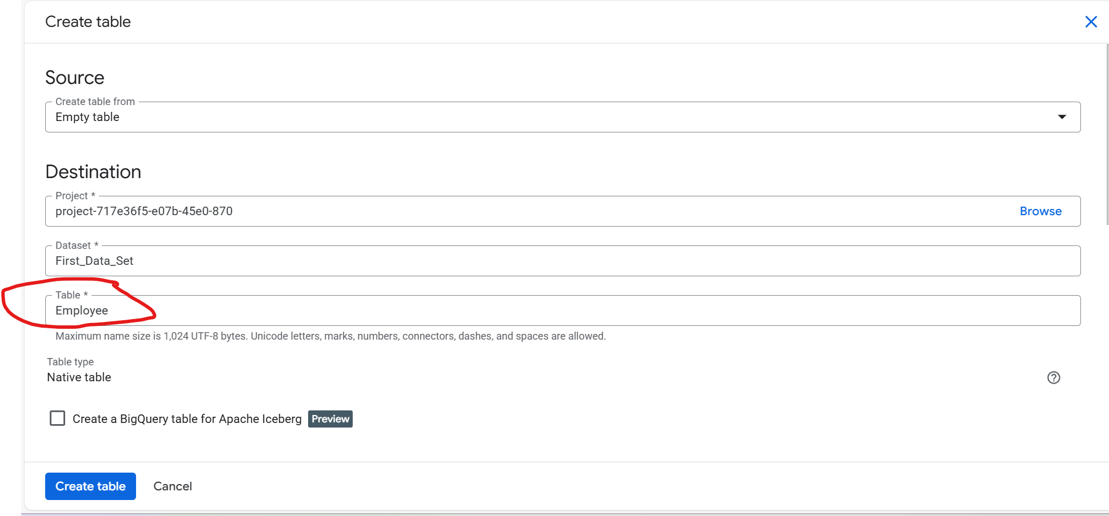
Source-Empty table

Slide 20
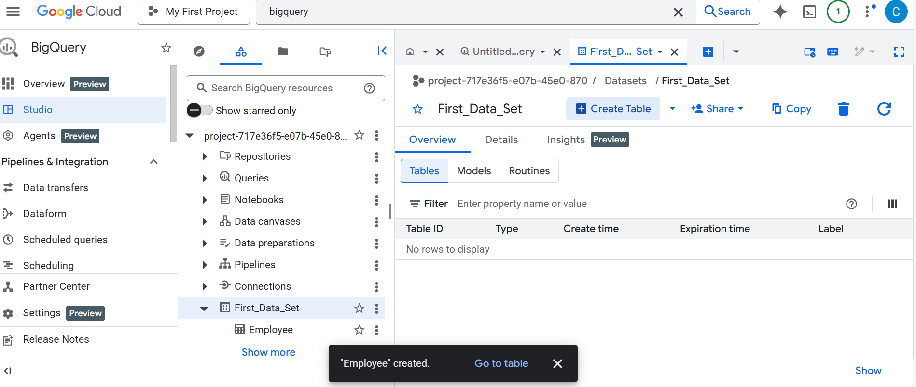

Slide 21
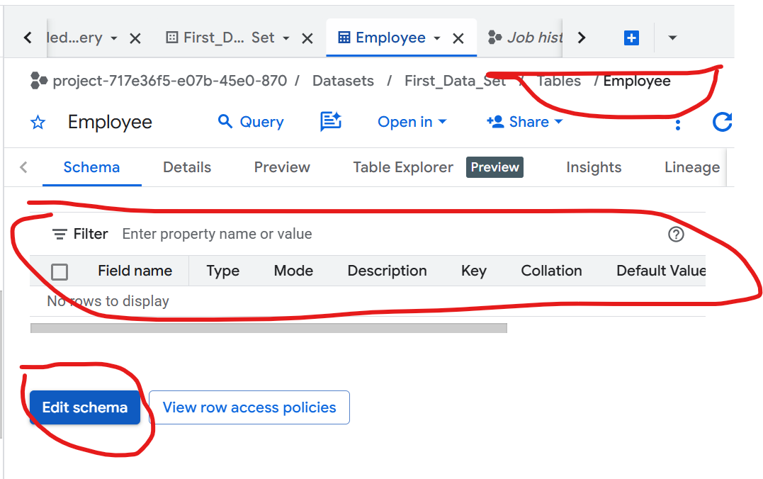

Slide 22
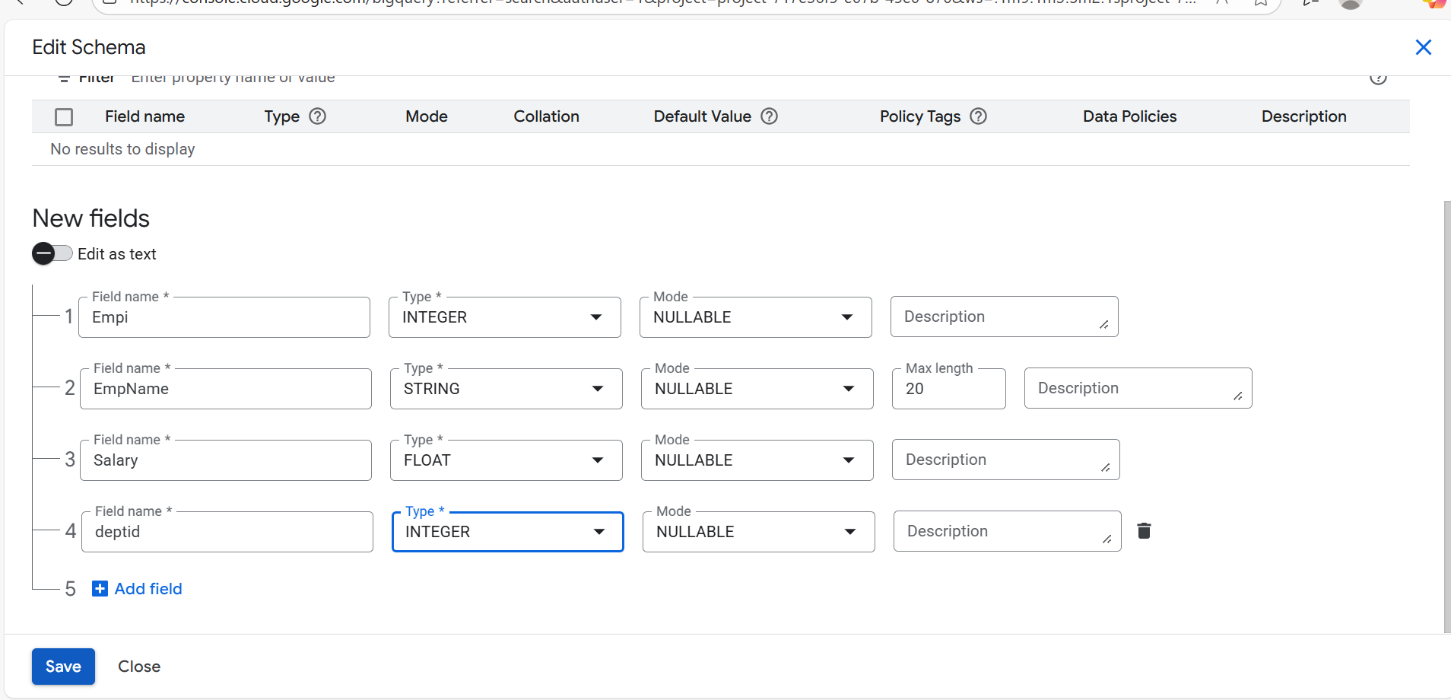

Slide 23
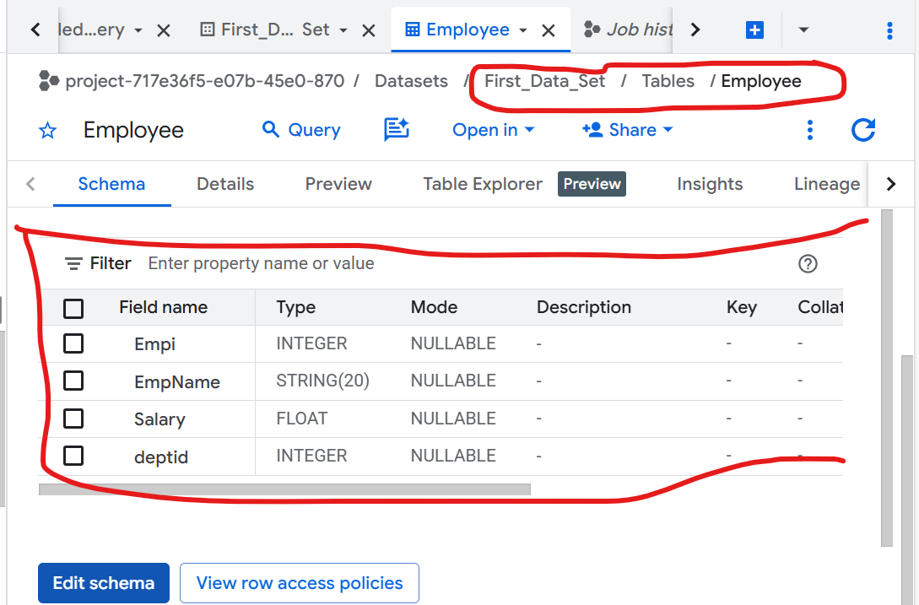

Slide 24
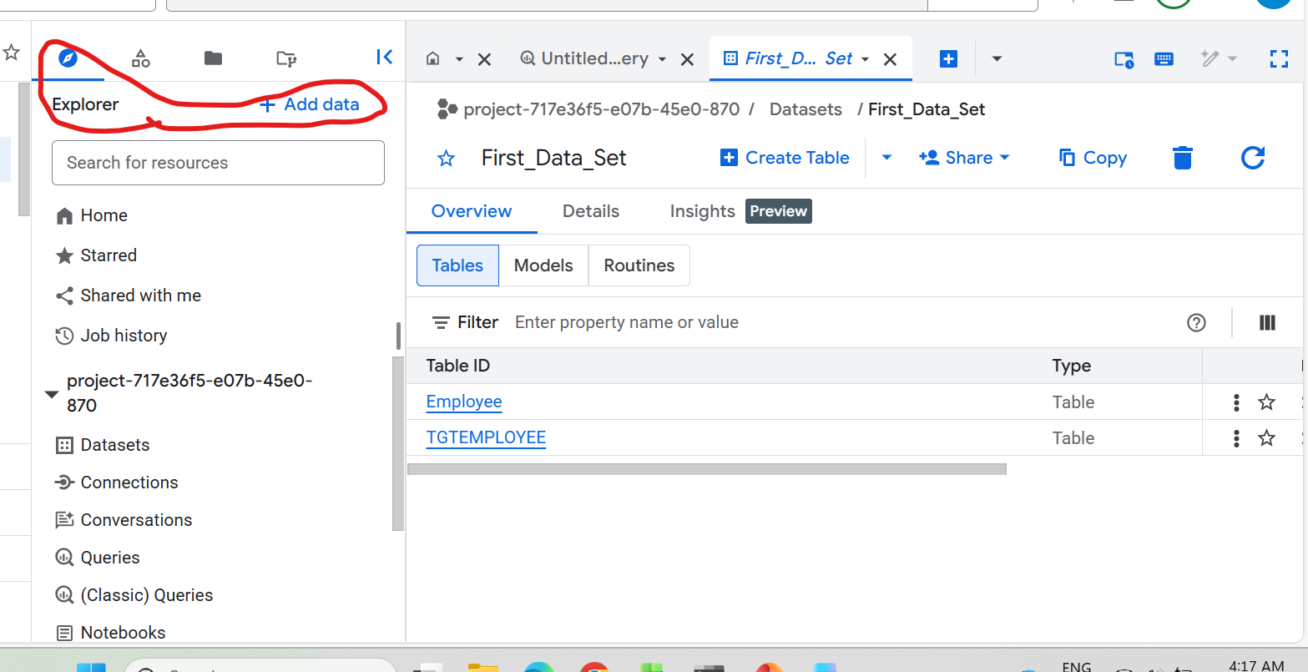
Add data to use local file to create table

Slide 25
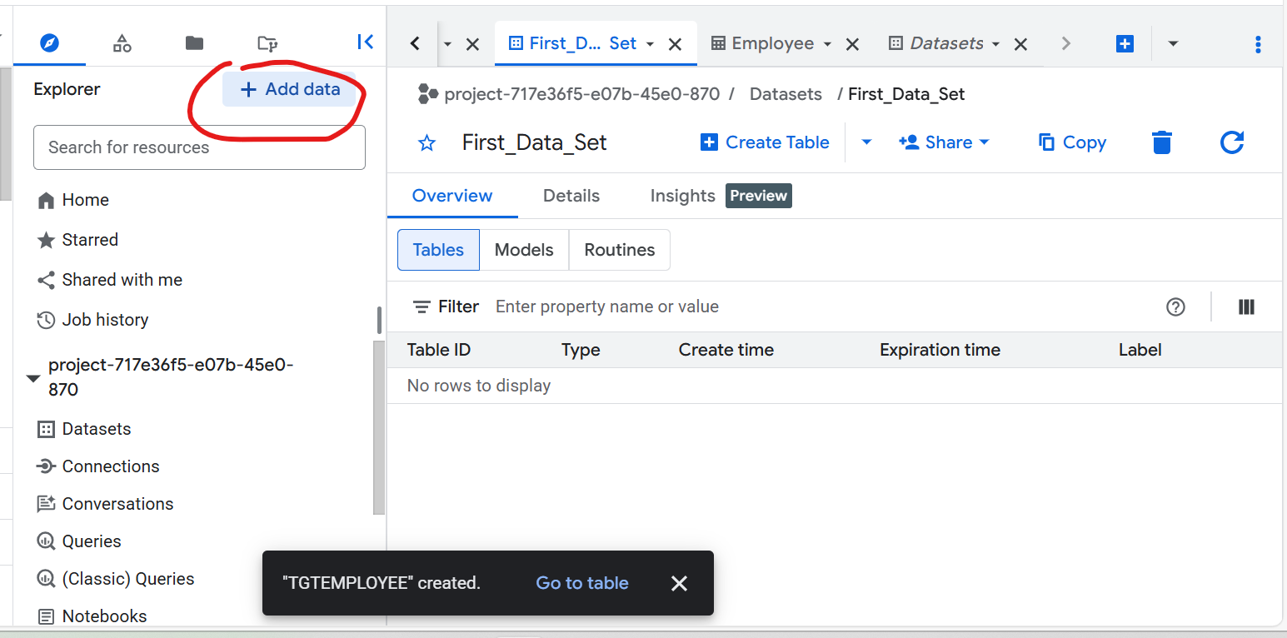
Add data to use local file to create table

Slide 26
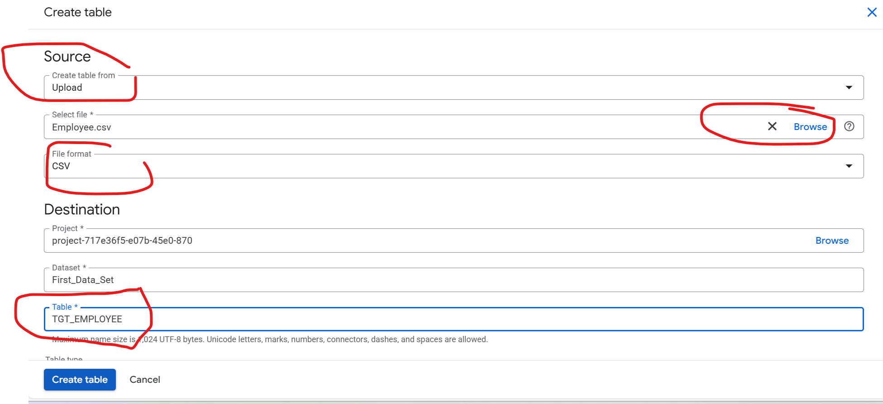
Create Table using Local File Upload Option

Slide 27
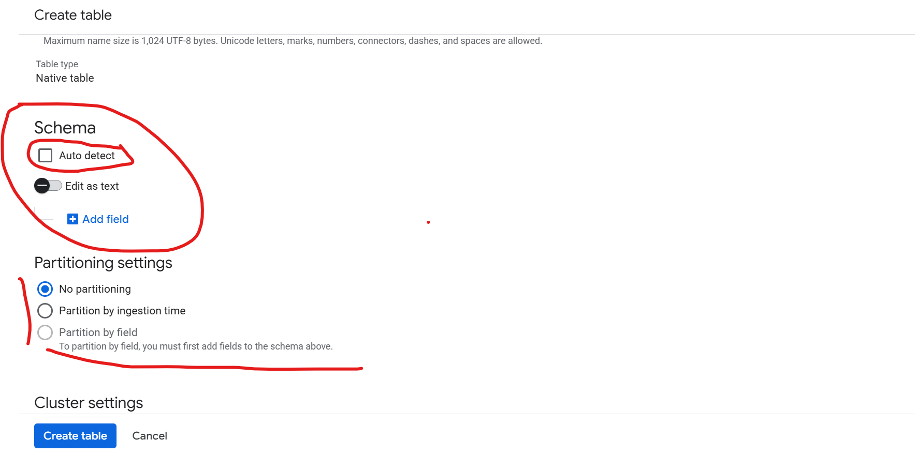
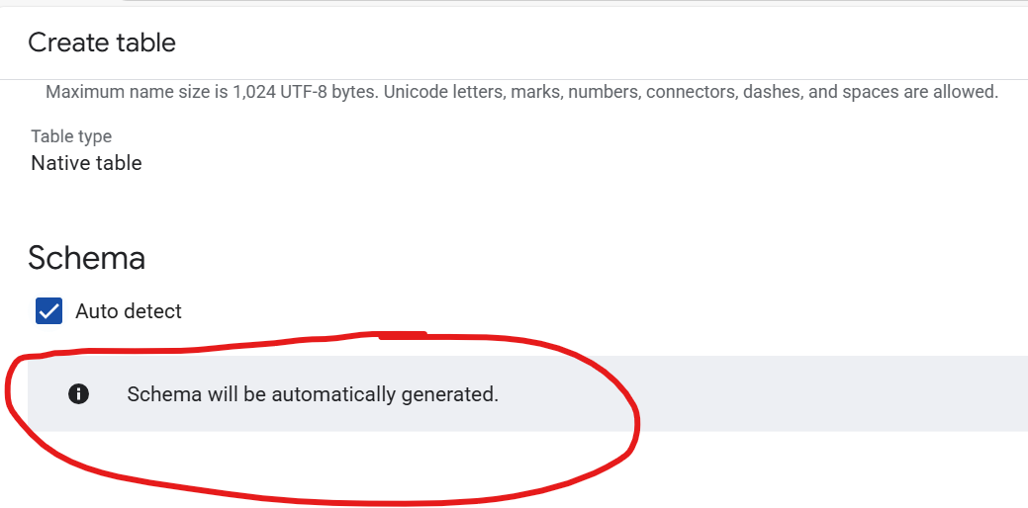
Auto-Detect Schema from file

Slide 28
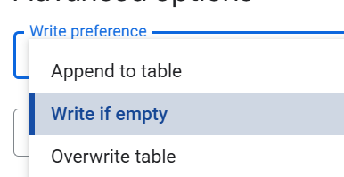
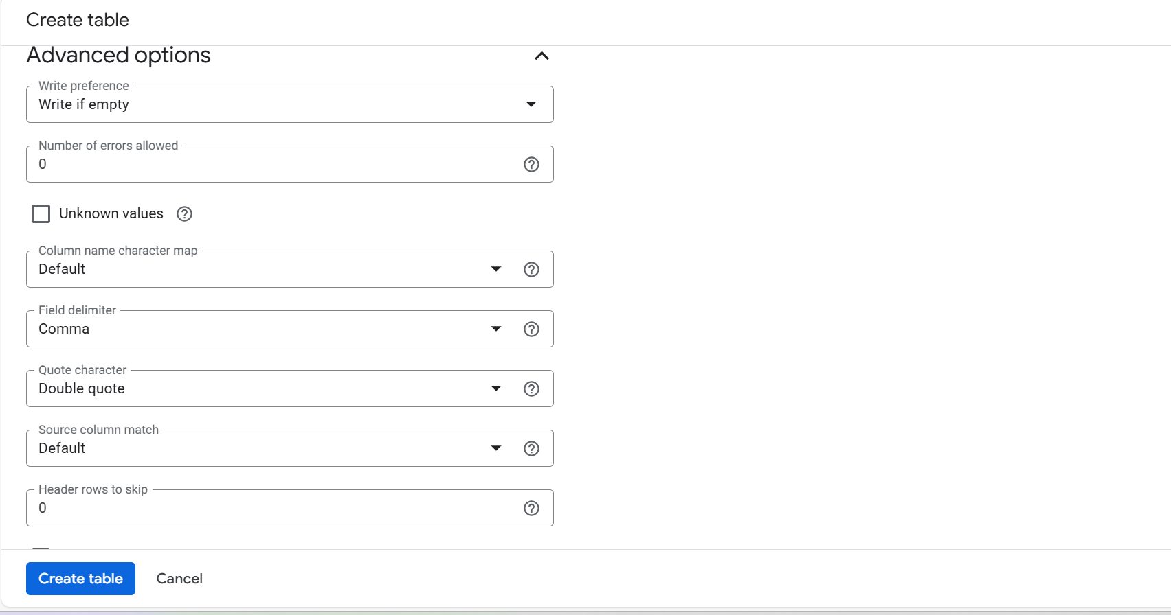
Adv options

Slide 29
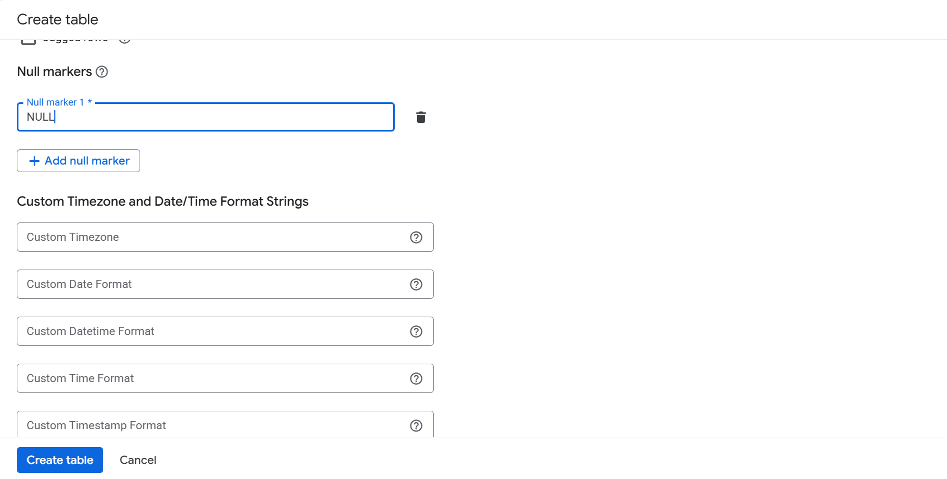
Add null marker

Slide 30
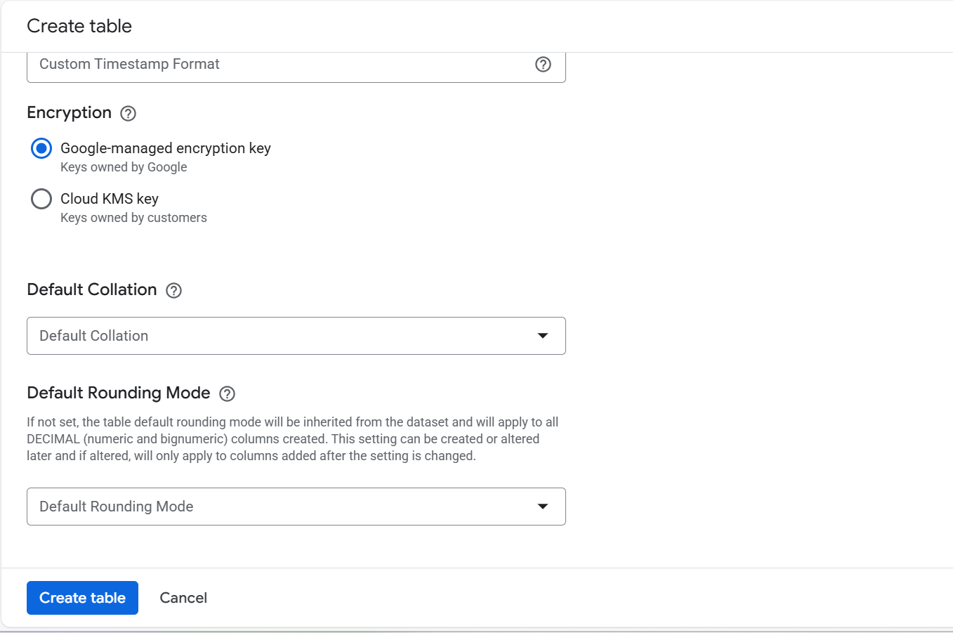
Encryption key

Slide 31
Add data to use local file to create table

Slide 32
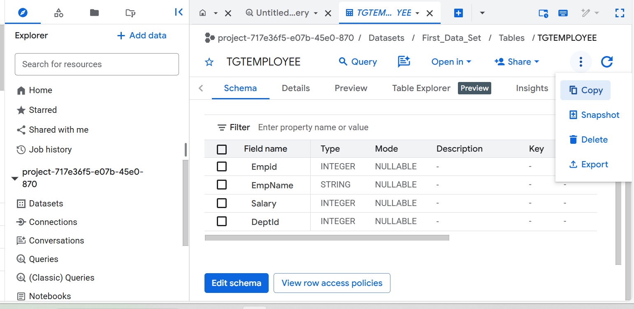

Slide 33
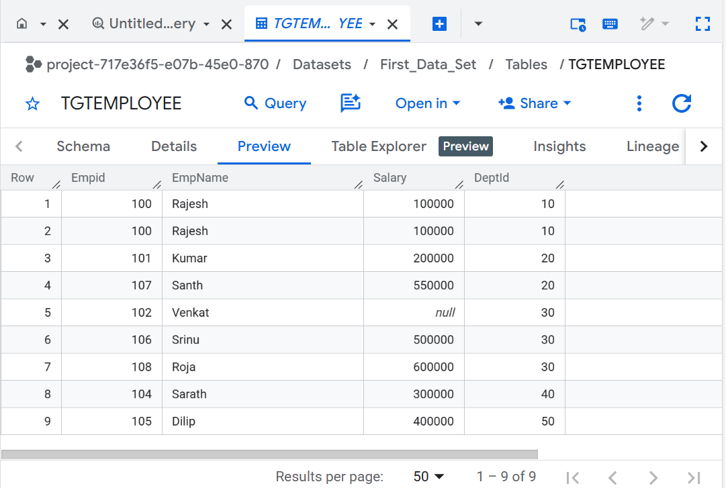
Data Preview after table creation with local file upload and auto schema detect using Add Data Option

Slide 34
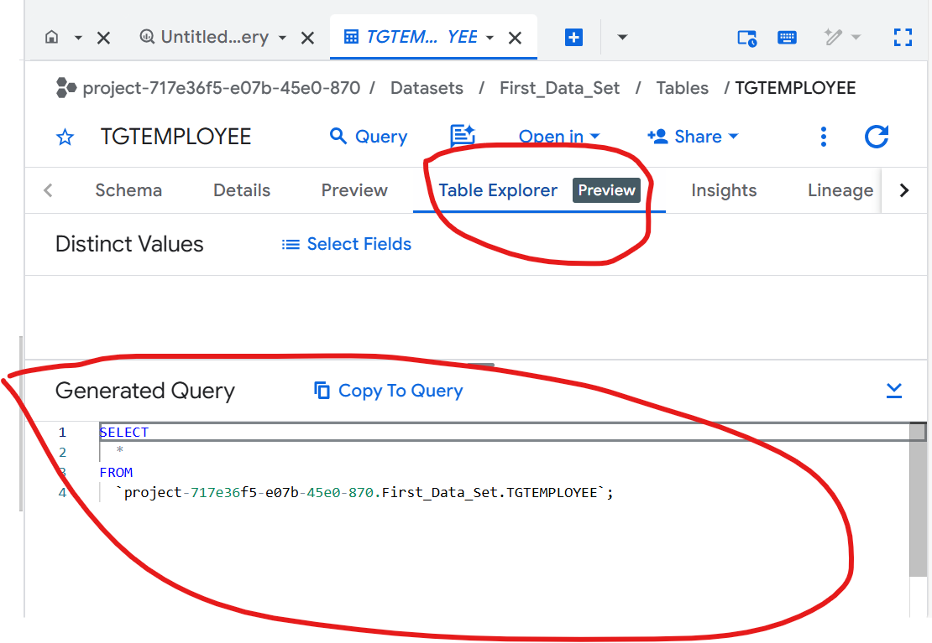
Table Explorer option

Slide 35
Queries - BigQuery

Slide 36
BigQuery supports standard SQL for querying, joining, aggregating, transforming, and modifying large-scale datasets using SELECT, DML, CTAS, and analytical window functions.

Slide 37
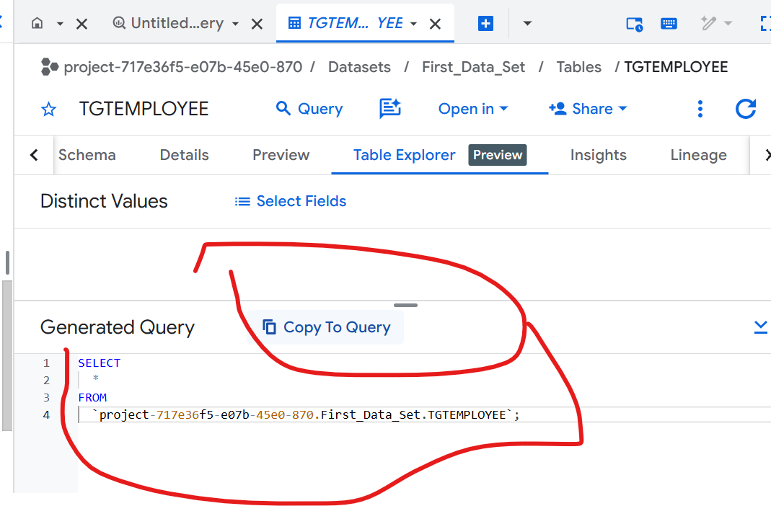
Basic SELECT queries

Slide 38
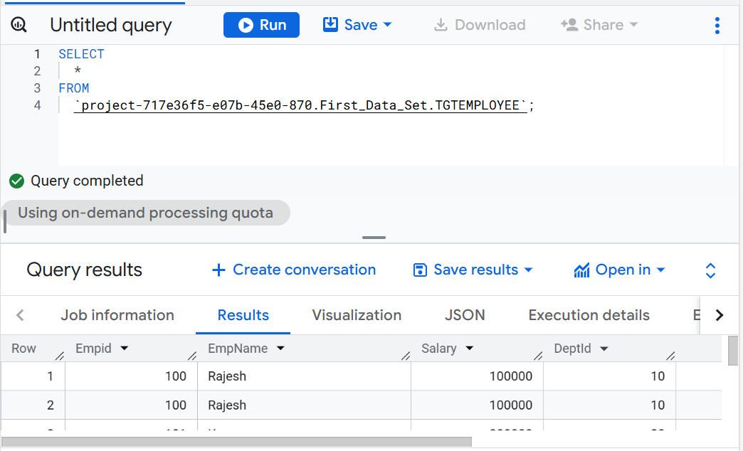
Copy to query → Run Select

Slide 39
2️⃣ Filtering & sorting
SELECT *
FROM dataset.orders
WHERE order_date >= '2024-01-01'
ORDER BY order_date DESC;

Slide 40
3️⃣ Aggregations
SELECT department, COUNT(*) AS emp_count
FROM dataset.employees
GROUP BY department;
SELECT SUM(amount) AS total_sales
FROM dataset.orders;

Slide 41
4️⃣ Handling NULLs
SELECT *
FROM dataset.employees
WHERE manager_id IS NULL;
SELECT IFNULL(bonus, 0) AS bonus
FROM dataset.employees;

Slide 42
5️⃣ Joins
SELECT o.order_id, c.customer_name
FROM dataset.orders o
JOIN dataset.customers c
ON o.customer_id = c.customer_id;
SELECT *
FROM orders o
LEFT JOIN payments p
ON o.order_id = p.order_id;

Slide 43
6️⃣ Deduplication
SELECT *
FROM (
SELECT *,
ROW_NUMBER() OVER (
PARTITION BY email
ORDER BY updated_at DESC
) AS rn
FROM dataset.users
)
WHERE rn = 1;

Slide 44
7️⃣ Data type conversions
SELECT SAFE_CAST(salary AS INT64)
FROM dataset.employees;
SELECT DATE(order_timestamp)
FROM dataset.orders;

Slide 45
8️⃣ Update / Delete (DML)
UPDATE dataset.employees
SET status = 'INACTIVE'
WHERE last_login < DATE_SUB(CURRENT_DATE(), INTERVAL 1 YEAR);
DELETE FROM dataset.orders
WHERE order_date < '2019-01-01';

Slide 46
9️⃣ MERGE (UPSERT – very important)
MERGE dataset.customers t
USING dataset.customers_staging s
ON t.customer_id = s.customer_id
WHEN MATCHED THEN
UPDATE SET name = s.name, city = s.city
WHEN NOT MATCHED THEN
INSERT (customer_id, name, city)
VALUES (s.customer_id, s.name, s.city);

Slide 47
🔟 Create table from query (CTAS)
CREATE TABLE analytics.high_value_customers AS
SELECT customer_id, SUM(amount) total_spend
FROM dataset.orders
GROUP BY customer_id
HAVING total_spend > 100000;

Slide 48
1️⃣1️⃣ Views
CREATE VIEW reporting.active_users AS
SELECT *
FROM dataset.users
WHERE status = 'ACTIVE';

Slide 49
1️⃣2️⃣ Window / analytics queries
SELECT *,
RANK() OVER (PARTITION BY department ORDER BY salary DESC) AS rank
FROM dataset.employees;

Slide 50
1️⃣3️⃣ Metadata queries
SELECT table_name, row_count
FROM dataset.INFORMATION_SCHEMA.TABLES;

Slide 51
